Slide 1



Sales Data Analysis Case Study Using Adventure Works sample database and Power BI
View in Power BI
Case study prepared by Mohammad Juned Khan

Slide 2
Business Demand
Hi, Analytics Team.
Management has decided to make improvement in our internal sales reports and we have decided to shift to Power BI dashboard.
Business Question we have are :
We want to know how much we sold and what product . And sales progress over time (years).
Analyze our sales on different products and customers.
It should also include the functionality of filtering the data .
Compare our value against performance and measure number against the budget.
The present year is 2021, for same we have budget. Management wants to look for two years of analytics for sales to prepare new strategies and decisions.

Slide 3
Data Analysis Project Roadmap
Ask
Prepare
Process
Analyze
Share
Act
Ask the Right set of Question to understand the requirement and demand for data analysis.
Validate the requirement and document objective.
Prepare a Plan for data analysis with task description.
Collect the data and prepare it for analysis (cleaning, transforming).
Analyze the data to answer the business questions.
Identify trends and key insights.
Prepare a report to showcase your findings and share it with stakeholders.
Validate your findings with help of subject matter expert and make data driven decisions.

Slide 4
User Story
No # | As a (role) | I want (request / demand) | So that I (user value) | Acceptance Criteria
1 | Sales Manager | To get a dashboard overview of internet sales | Can follow better which customers and products sells the best | A Power BI dashboard which updates data once a day
2 | Sales Representative | A detailed overview of Internet Sales per Customers | Can follow up my customers that buys the most and who we can sell ore to | A Power BI dashboard which allows me to filter data for each customer
3 | Sales Representative | A detailed overview of Internet Sales per Products | Can follow up my Products that sells the most | A Power BI dashboard which allows me to filter data for each Product
4 | Sales Manager | A dashboard overview of internet sales | Follow sales over time against budget | A Power Bi dashboard with graphs and KPIs comparing against budget.

Slide 5
Project Steps
Data Selection
Data Staging
Prepare Dashboard
Data Filtering
Upload data to Power BI
Database
Adventure Works sample databases in SQL Server.
Write SQL query to filter data based on requirements.
Save the Query Results in CSV files.
Upload all csv files and budget file to Power BI. Create a data model and describe relations between tables.
Prepare Dashboard based on requirements

Slide 6
Data Selection From SQL Database
Data Selection
Dimension Tables
Fact Table
Date Table
Customer Table
Product Table
Budget Table
Internet Sales Fact Table

Slide 7
Data Selection and Filtering
1. Date Table
Date Dimension table cleaning
/****** Script for Filtering Date Dimension for Sales Analytics from Data Set ******/
SELECT [DateKey]
,[FullDateAlternateKey] AS Date
,[EnglishDayNameOfWeek] AS Day
,[EnglishMonthName] AS Month
,LEFT([EnglishMonthName],3) as MonthName
,[MonthNumberOfYear] AS MonthNumber
,[CalendarQuarter] AS Quarter
,[CalendarYear] AS Year
FROM [AdventureWorksDW2014].[dbo].[DimDate]
WHERE
CalendarYear >= 2019

Slide 8
Data Selection and Filtering
2. Customer Table
Customer Dimension table cleaning
/****** Script for Filtering and Cleaning Customer data ******/
SELECT c.[CustomerKey] AS CustomerKey
,c.[FirstName] AS [First Name]
,c.[LastName] AS [Last Name]
--full name --
,c.[FirstName] + ' ' + [LastName] AS [Full Name],
CASE c.[Gender] WHEN 'M' THEN 'MALE' WHEN 'F' THEN 'FEMALE' END AS Gender
,c.[DateFirstPurchase] AS [DateFirstPurchase]
,g.[City] AS [Customer City]
,g. [EnglishCountryRegionName] AS [Country]
FROM [AdventureWorksDW2014].[dbo].[DimCustomer] AS c
LEFT JOIN [AdventureWorksDW2014].[dbo].[DimGeography] AS g on g.[GeographyKey] = c.[GeographyKey]
ORDER BY
[CustomerKey] ASC

Slide 9
Data Selection and Filtering
3. Product Table
Product Dimension table cleaning
/****** Script for product table ******/
SELECT p.[ProductKey] ,p.[ProductAlternateKey] AS [ProductItemCode] ,p.[EnglishProductName] AS [Product Name]
-- Get the product Sub Category
,ps.[EnglishProductSubcategoryName] AS [Product Sub-Category]
-- Get Product Category
,pc. [EnglishProductCategoryName] AS [Product Category] ,p.[Color] AS [Product Color] ,p.[Size] AS [Size] ,p.[ProductLine] AS [Product Line] ,p.[ModelName] AS [Product Model Name]
,p. [EnglishDescription] AS [Product Description] ,ISNULL(p.[Status],'Outdated') AS [Product Status]
FROM [AdventureWorksDW2014].[dbo].[DimProduct] AS p
-- First join the product table with Sub Category table
LEFT JOIN [AdventureWorksDW2014].[dbo].[DimProductSubcategory] AS ps ON
ps.[ProductSubcategoryKey] = p.[ProductSubcategoryKey]
-- then join the Sub Category table with Category table
LEFT JOIN [AdventureWorksDW2014].[dbo].[DimProductCategory] AS pc ON
ps.[ProductCategoryKey] = pc.[ProductCategoryKey]
ORDER by p.[ProductKey] ASC

Slide 10
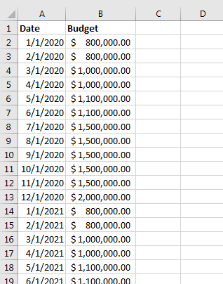
Data Selection
4. Budget Table

Slide 11
Data Selection and Filtering
1. Internet Sales Fact Table
Internet Sales Fact table cleaning
/****** Script for Cleaning Internet Sales Table ******/
SELECT [ProductKey] ,[OrderDateKey]
,LEFT([OrderDateKey],4) AS OrderYear
-- To Extract Order year.
,[DueDateKey] ,[ShipDateKey]
,[CustomerKey] ,[SalesOrderNumber]
,[SalesAmount]
FROM [AdventureWorksDW2014].[dbo].[FactInternetSales]
WHERE
-- To Extract Internet Sales of last 2 year from present year.
-- We use YEAR(GETDATE()) function to get present date.
LEFT([OrderDateKey],4)>= YEAR(GETDATE())-2
ORDER BY
[OrderDateKey] ASC

Slide 12
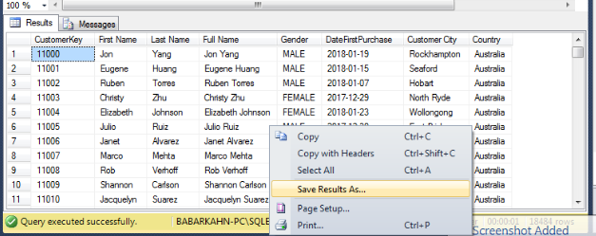
Data Staging
Store The Query Results in CSV file

Slide 13
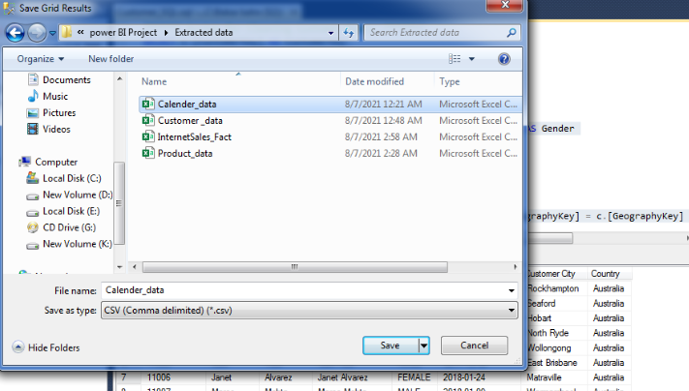
Data Staging
Save the CSV file in local system storage

Slide 14
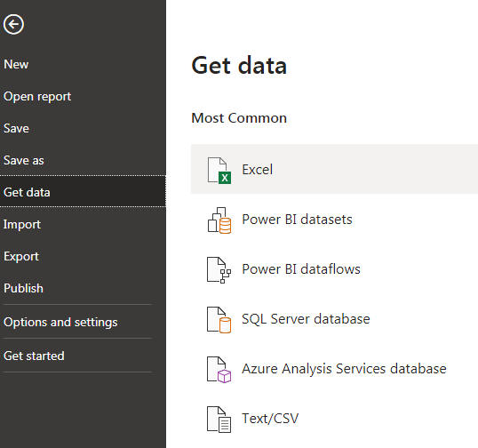
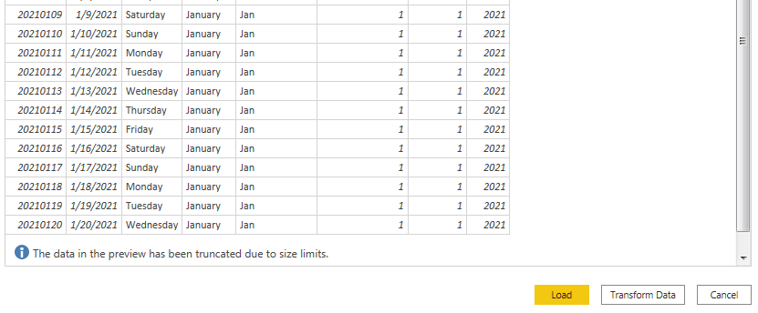
Upload Data in Power BI
Upload all data files in Power BI
Step 1- Go to Files, select Get Data and then Text/CSV option
Step 2-Select file you have in Staging Area and then load it
Step 3-Upload all the files in Power BI

Slide 15
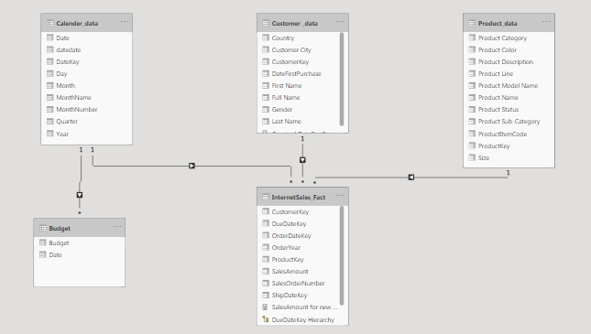
Data Model in Power BI
Create a data model for dashboard

Slide 16
Create Dashboard in Power BI
Dashboard Detail
Pages required
Sales Overview
Product Overview
Customer Overview
Influence and Forecast
Q & A

Slide 17
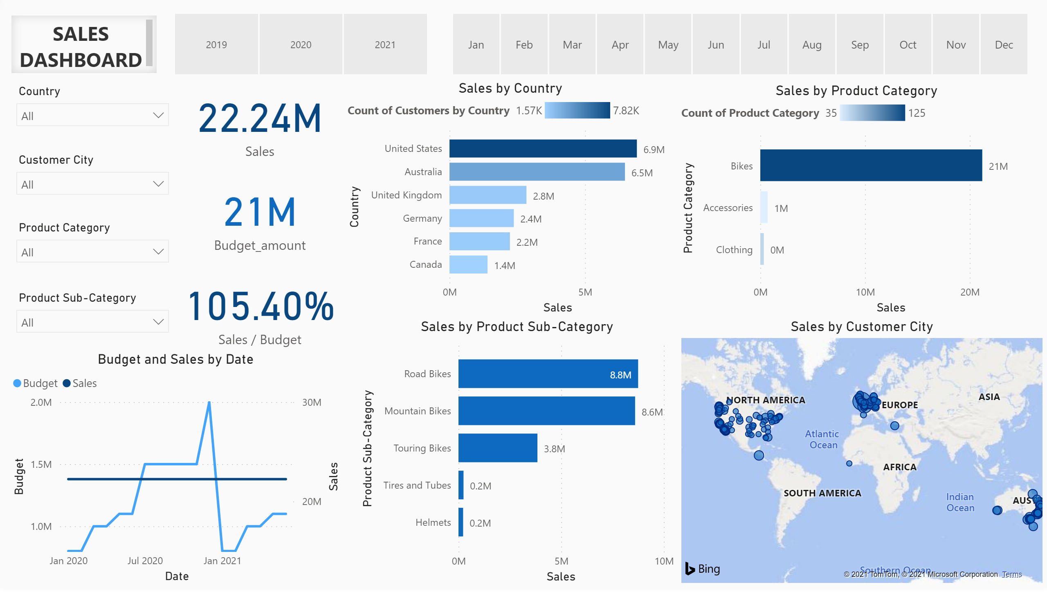
Sales Overview
Notes:
textbox
No alt text provided.
slicer
No alt text provided.
slicer
No alt text provided.
slicer
No alt text provided.
slicer
No alt text provided.
slicer
No alt text provided.
slicer
No alt text provided.
Total Sales
No alt text provided.
Budget
No alt text provided.
card
No alt text provided.
barChart
No alt text provided.
barChart
No alt text provided.
barChart
No alt text provided.
lineChart
No alt text provided.
map
No alt text provided.

Slide 18
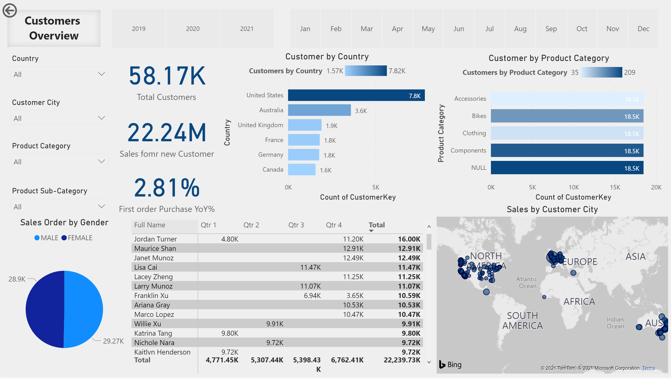
Customers Detail
Notes:
textbox
No alt text provided.
slicer
No alt text provided.
slicer
No alt text provided.
slicer
No alt text provided.
slicer
No alt text provided.
slicer
No alt text provided.
slicer
No alt text provided.
Total Sales
No alt text provided.
Budget
No alt text provided.
card
No alt text provided.
Customer by Country
No alt text provided.
Customer by Product Category
No alt text provided.
Sales Order by Gender
No alt text provided.
map
No alt text provided.
pivotTable
No alt text provided.
actionButton
No alt text provided.

Slide 19
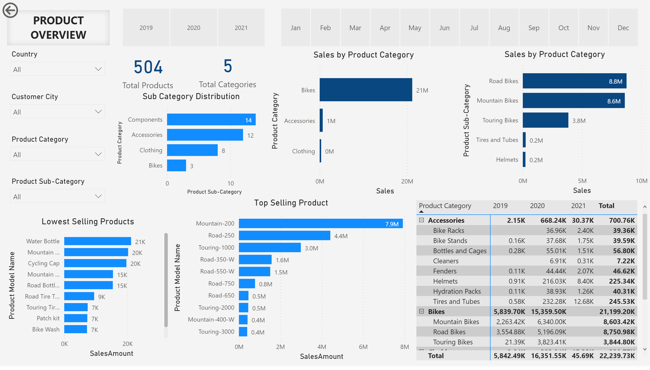
Product Detail
Notes:
textbox
No alt text provided.
slicer
No alt text provided.
slicer
No alt text provided.
slicer
No alt text provided.
slicer
No alt text provided.
slicer
No alt text provided.
slicer
No alt text provided.
Total Sales
No alt text provided.
Budget
No alt text provided.
Sales by Product Category
No alt text provided.
Sub Category Distribution
No alt text provided.
actionButton
No alt text provided.
Sales by Product Category
No alt text provided.
pivotTable
No alt text provided.
Top Selling Product
No alt text provided.
Lowest Selling Products
No alt text provided.

Slide 20
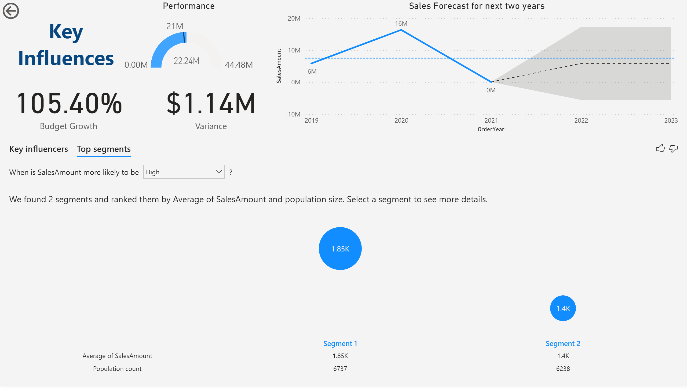
Influences & Forecast
Notes:
keyDriversVisual
No alt text provided.
actionButton
No alt text provided.
textbox
No alt text provided.
card
No alt text provided.
Performance
No alt text provided.
card
No alt text provided.
Sales Forecast for next two years
No alt text provided.

Slide 21
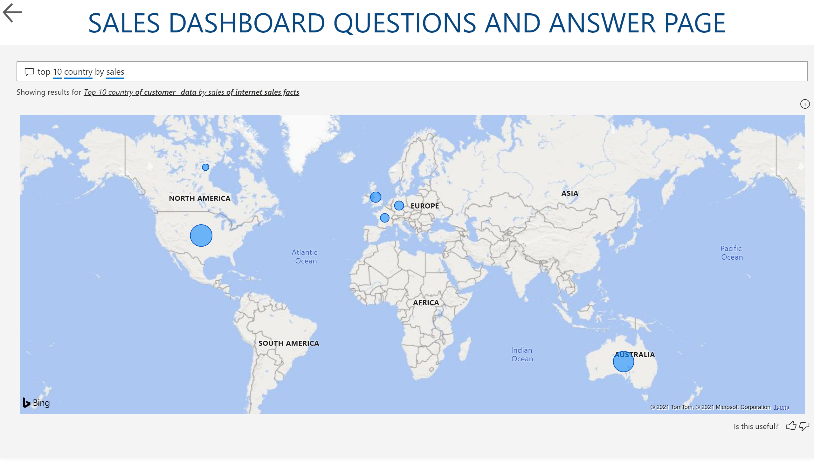
Q&A
Notes:
qnaVisual
No alt text provided.
textbox
No alt text provided.
actionButton
No alt text provided.

Slide 22
Act
ACT Phase
The Dashboard will help the management to take:-
Form new strategies to increase the sales of product.
It will help Marketing and sales team to focus on potential customers.
Management can make decisions based on key finding and facts.
It help in retaining the customers.
Influence and Forecast will help management achieve business goals.
Q & A will help management get customized answers.
Case study prepared by Mohammad Juned Khan

